Slide 1
White Blood Cell Subtype Identification Using ResNet Architecture
Done by
Aneeta L R
Under the guidance of
Prof. Nisha Markose

Slide 2
Introduction

Slide 3
WBC is made in the bone marrow and found in the blood and lymph tissue.
Help the body fight infection and other diseases
Types of WBC : Neutrophils, Lymphocytes, Eosinophils, Basophils and Monocytes.
Blood smear analysis done by a pathologist using microscope is used to observe WBC cells can cause error.
CNN have successfully been applied to classify images of biological features.
ResNet is one of the most powerful deep neural networks. Because it overcome vanishing gradient problem
The classic ResNet architecture is ResNet50 i.e., ResNet with 50 layers, but here we use a customized ResNet with 24 layers which is similar to ResNet50.
The dataset used is blood cell images from Kaggle.
By detecting the type of WBC, this model helps doctors to diagnose a patient easily.
inflammatory disease, bacterial or viral infection, leukaemia, allergic reaction,etc.

Slide 4
Literature Review

Slide 5
Paper 1: -Vatathanavaro, Supawit, Suchat Tungjitnob, and Kitsuchart Pasupa. "White blood cell classification: a comparison between VGG-16 and ResNet-50 models." proceeding of the 6th joint symposium on computational intelligence (JSCI6). Vol. 12. 2018.
There are two main methods for WBC classification task.
Automated blood analysers - high accuracy but cost and maintenance are incredibly high
Human analysis of microscopic images – difficult to identify due to a similarity in appearance
CNN is the best algorithm
VGG-16 and ResNet-50
Optimal number of epochs for the VGG-16 and the ResNet-50 is 44 and 47
Accuracy is greater for ResNet50 than VGG16.

Slide 6
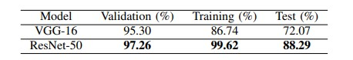

Slide 7
Paper 2: - He, Kaiming, et al. "Deep residual learning for image recognition." Proceedings of the IEEE conference on computer vision and pattern recognition. 2016.
Deeper neural networks are more difficult to train
In deep neural networks adding more layers leads to the model’s accuracy saturating, then rapidly decaying, and higher training errors
Instead of hoping every few stacked layers directly fit a desired underlying mapping, these layers can be fit using residual mapping
To optimize the residual mapping function than to optimize the original, unreferenced mapping
Features like Shortcut Connection, bottleneck
ResNet with an increase in depth and the error was lower compared to simple CNN

Slide 8
Paper 3: - Habibzadeh, Mehdi, et al. "Automatic white blood cell classification using pre-trained deep learning models: Resnet and inception." Tenth international conference on machine vision (ICMV 2017). Vol. 10696. SPIE, 2018.
Details about WBC
Inception and Resnet50
Different input size
The possibility of extending the use of ResNet will continue to contribute to medical fields.

Slide 9
Findings
Resnet is more efficient than other architecture
Increase in the number of layers can cause vanishing gradient problem and resnet can overcome them
Identity shortcut connection
Resnet led to major improvements in Image recognition, image detection, image localization, and segmentation tasks
Has more layers but lesser parameters than previous models hence making it fast
Reconstructing or customizing of ResNet is possible

Slide 10
SYSTEM ANALYSIs
Analysis of Dataset - Blood cell images

Slide 11
https://www.kaggle.com/code/yvtsanlevy/96-accuracies-blood-cell-recognistion-with-resnet/data?select=blood_cell_images.zip
Size 129 MB
Image size 240 x 320 x 3
5106 images
Classes are Eosinophil, Lymphocyte, Monocyte, and Neutrophil
Training - 2548 images, testing - 2487 images and validation – 71 images
In training 2497 - eosinophil, 2483 - lymphocyte, 2478 - monocyte and 2499 - neutrophil
In test 623 images - eosinophil, 620 - lymphocyte, 620 - monocyte and 624 - neutrophil
In validation set 13 images - eosinophil, 6 - lymphocyte, 4 - monocyte and 48 – neutrophil
Pre-processing of images involves rotation, width shift, height shift, shear, zoom, horizontal flip, and vertical flip using ImageDataGenerator

Slide 12
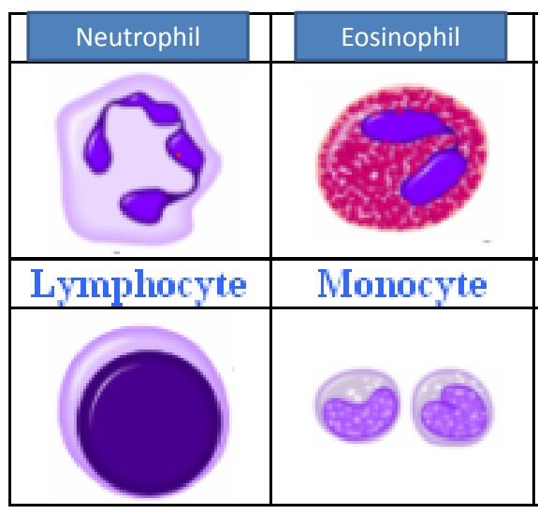

Slide 13
WBC are white or colourless blood cells
Function is to protect the body against micro organisms causing diseases
Formed in bone marrow
60% - 70% of WBC are neutrophil
They are normally 10-12 micrometer in diameter
Contain 2 -5 lobes connected together by a thin strand of chromatin
Cytoplasm has very fine, pale lilac granules
It destroys harmful bacteria
Eosinophil is 2% - 4% of WBC
10 – 12 micrometer diameter
2 or 3 lobes, large, red-orange granules filled with cytoplasm
It combats the effects of histamine in allergic reactions, destroy parasitic worms

Slide 14
Monocytes are 3% - 8% of WBC
They have 12 – 20 micrometer diameter
Nucleus is kidney shaped or house shoe shaped
Cytoplasm is blue-grey and has foamy appearance
Phagocytosis, this occur after they transform into fixed or wandering macrophages
Lymphocyte are 20% - 25% of WBC
Small lymphocytes are 6 – 9 micrometer diameter, large ones are 10 – 14
Nucleus is round and slightly indented
Cytoplasm forms a rim around nucleus that looks sky blue
Larger the cell more cytoplasm is visible
Attacks invading virus, cancer cells and transplanted tissues

Slide 15
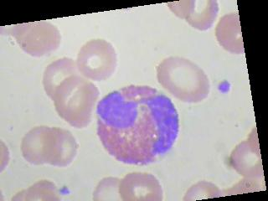
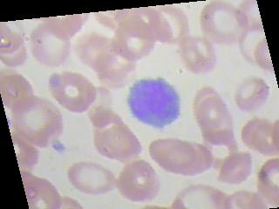
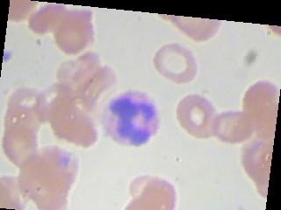
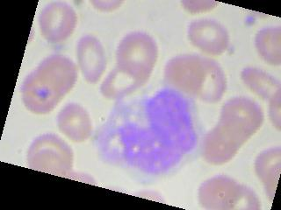
Eosinophil
Lymphocyte
Neutrophil
Monocyte

Slide 16
Analysis of Architecture

Slide 17
Features of ResNet
Input size 224 x 224 x 3
A residual network is formed by stacking several residual blocks together.
ResNet uses Batch Normalization at its core. The Batch Normalization adjusts the input layer to increase the performance of the network. The problem of covariate shift is mitigated.
ResNet makes use of the Skip Connection, which helps to protect the network from vanishing gradient problem.
Deep Residual Network uses bottleneck residual block design to increase the performance of the network.

Slide 18
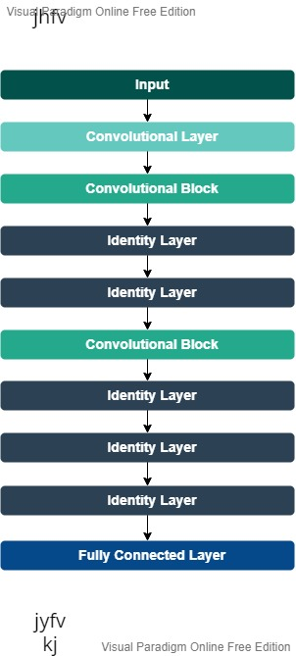

Slide 19
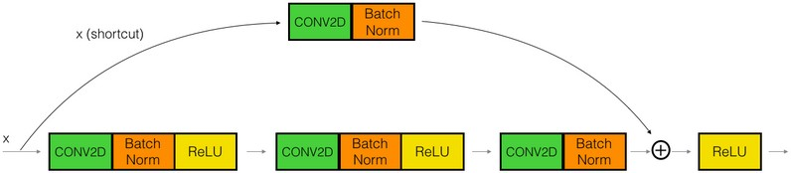
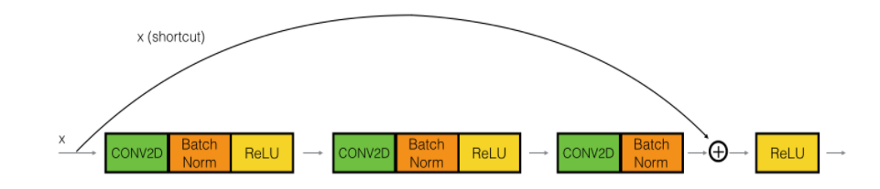
7 x 7 Convolutional layer with stride 2
3 x 3 Maxpooling layer with stride 2
Each convolution block has 3 convolutional layer and a shortcut convolutional layer
Each identity layer has 3 convolutional layer.
Fully connected layer
Convolutional block
Identity block

Slide 20
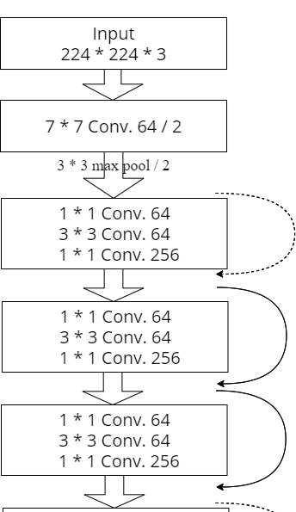
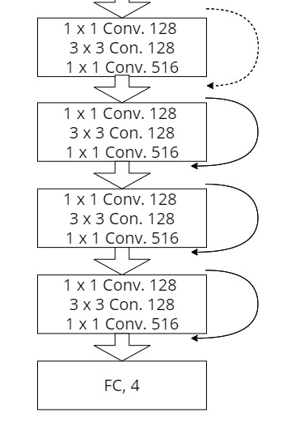

Slide 21
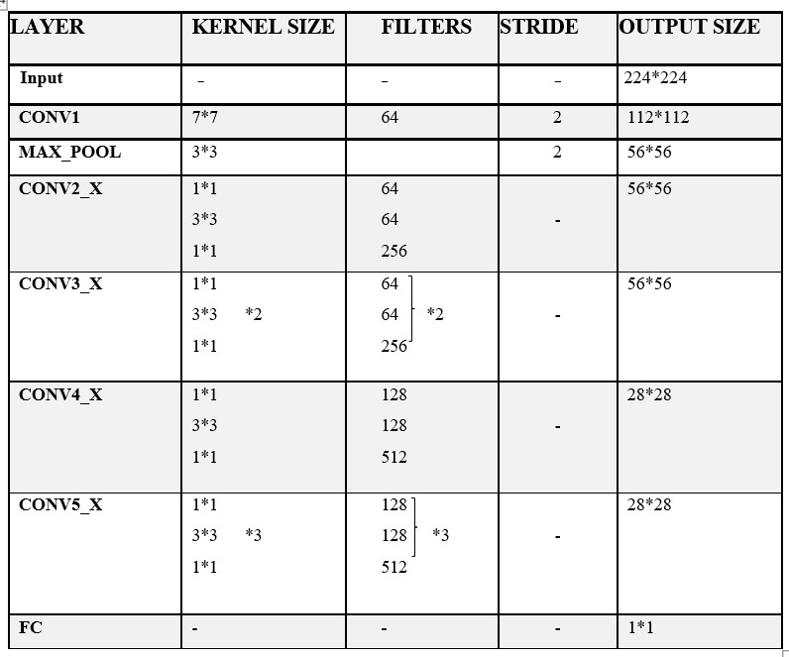

Slide 22
Project Pipeline

Slide 23
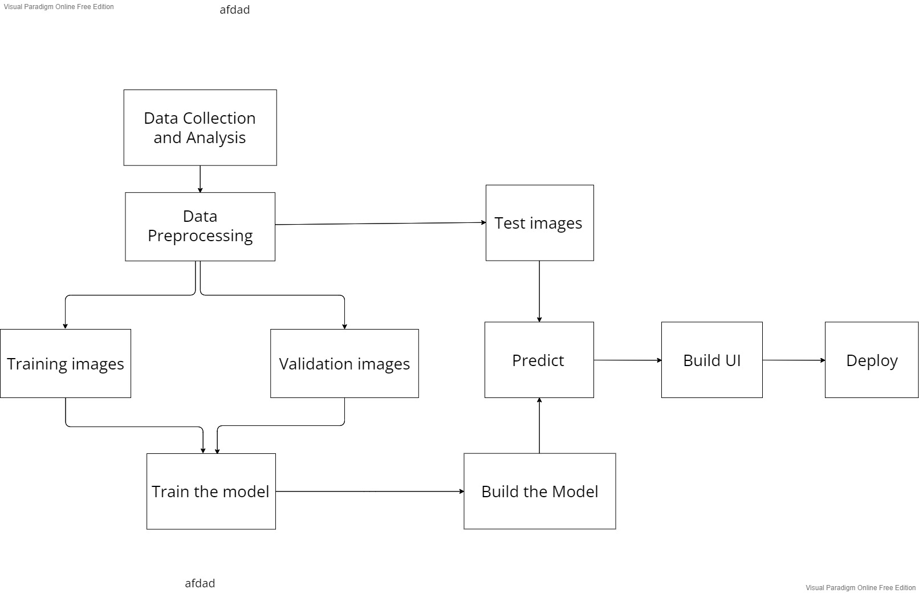

Slide 24
System Environment

Slide 25
Software Environment
Python libraries and packages – Numpy, Matplotlib, Tensorflow, Keras, Sklearn, Os
HTML, CSS and flask
Google Colab, Visual Studio Code, Github
Hardware Environment
Processor : 2 GHz or faster (dual-core or quad-core will be much faster)
Memory : 8 GB RAM or greater
Disk space : 40 GB or greater good internet connectivity

Slide 26
SYSTEM DESIGN

Slide 27
Pre-processed images using ImageDataGenerator
Build 2 function for defining identity block and convolutional block.
Build custom resnet.
Trained the model using 20 epoch
The trained model got highest accuracy at 17 th epoch that model’s weights are saved
The saved hyperparameters are used to build the model
Validation accuracy 90% and minimum validation loss 0.9877 for selected model
96% train accuracy

Slide 28
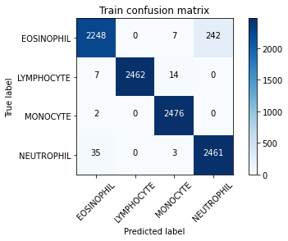

Slide 29
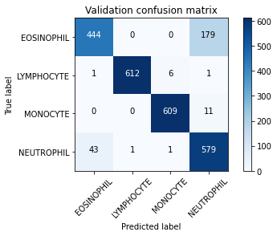

Slide 30
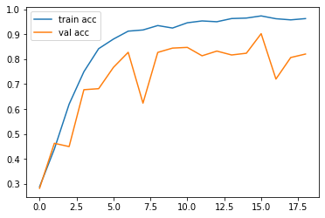
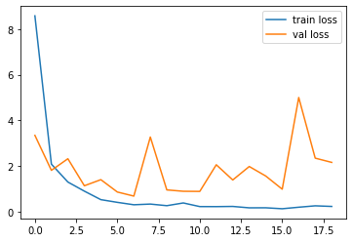
Accuracy
Loss

Slide 31
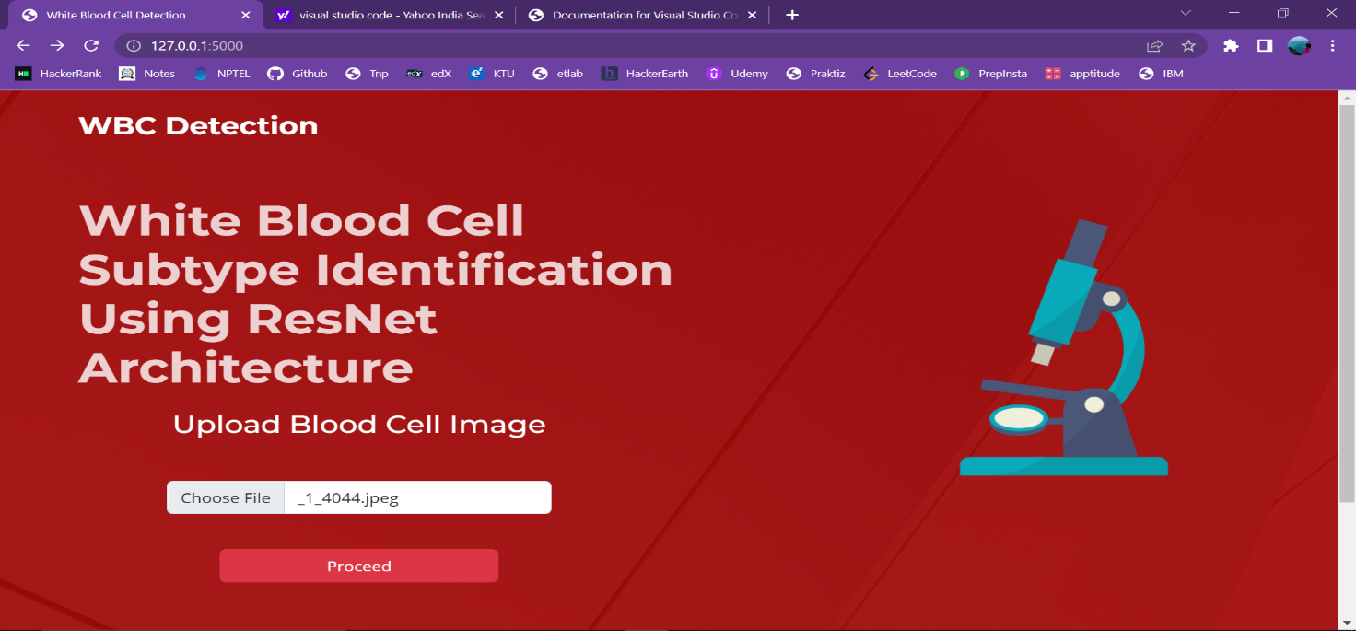

Slide 32
